Slide 1
Insights from the Univ. of Arizona AAU STEM reform effort in Physics
Reformed Class
Two 50 minute lectures per week
Focused on introducing concepts using active engagement instructional strategies and on collaborative group problem solving
Minimal derivations of equations
Each student also attends a 50 minute recitation sections per week
Led by graduate TA with assistance from undergraduate peer instructors
Students work on collaborative tutorials, which promote reasoning abilities and problem solving skills
Instructor experienced in astronomy and physics education research, but teaching PHYS 141 for the first time
Traditional Class
Three 50 minute lectures per week
Focused on introducing concepts and on instructor-led modeling of problem solving
Many derivations of equations
Instructor experienced in teaching PHYS 141 and widely regarded by faculty and students as an excellent lecturer

Slide 2
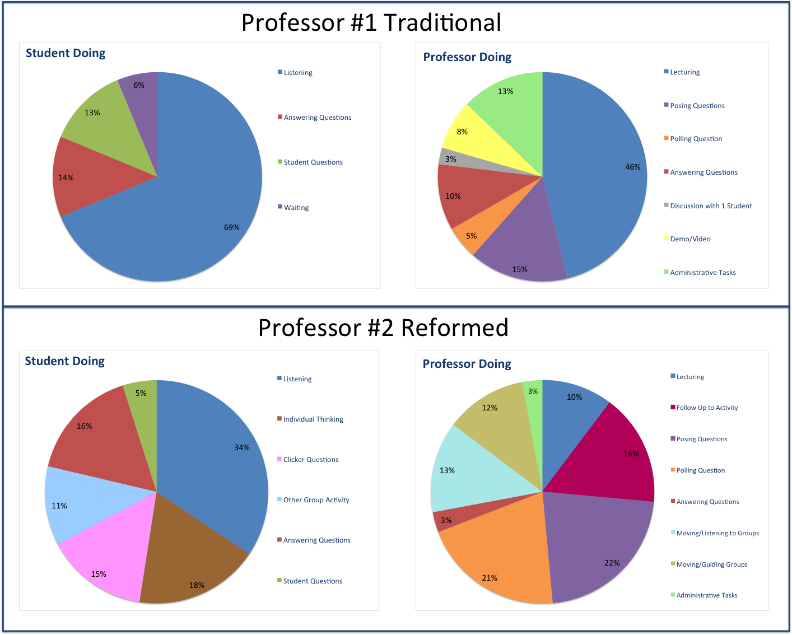
COPUS data from UA Calc-Physics Course Reforms

